Slide 1
Feature Selection & Feature learning

Slide 2
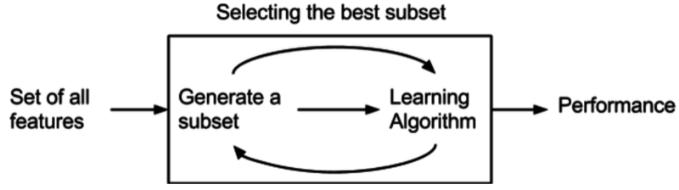
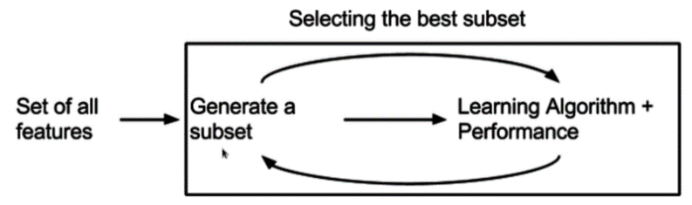
Feature Selection
Finding the best classifier by turning off features
Metaheuristics: Optimization-like techniques for feature subsets
Filters
Select variables regardless of the model
E.g. eliminate correlated features or least significant principal component
Wrappers
Evaluate subsets of features
Good performance with overfitting risk
High computational complexity
Embedded Methods
Are coupled with Learning Mechanisms
Recursive Feature Elimination algorithm:
Use SVM to repeatedly construct a model and remove features with low weights.
Typically computationally somewhat between wrappers and filters
Notes:
Or mean decrese in gini: describes imbalance or purity of nodes → in random forest, we compute mean decrease in gini after each split
High meand ecrease is good as it represents that the child nodes are purer than the parent node

Slide 3
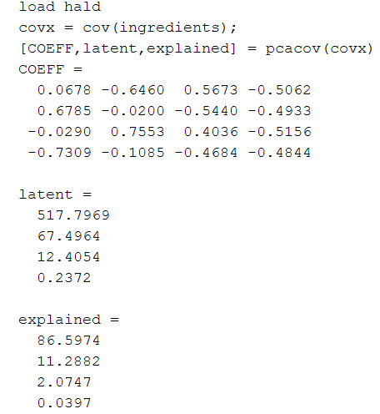
Feature Dimensionality Reduction
Problem:
Reduce dimensionality / eliminate redundant data without classifier?
Principle component analysis (PCA)
Main idea
highly covariant / correlated features deliver redundant information
Analyze covariance (correlation) matrix
Transform data into principle components
Find eigenvectors and eigenvalues
Normalized eigenvalues are weightings
Ignore components “low weightings”
Advantages:
Removes covariance from features
Reduces features / class. computation
Disadvantages
Does not indicate value of a feature
All features must be calculated for transformation

Slide 4
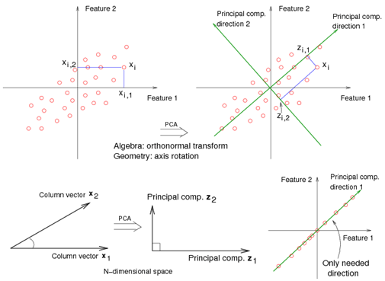
https://onlinecourses.science.psu.edu/stat857/book/export/html/11

Slide 5
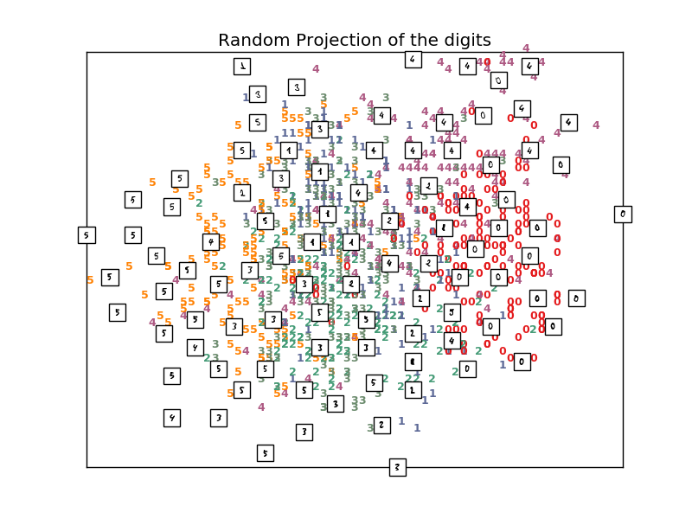
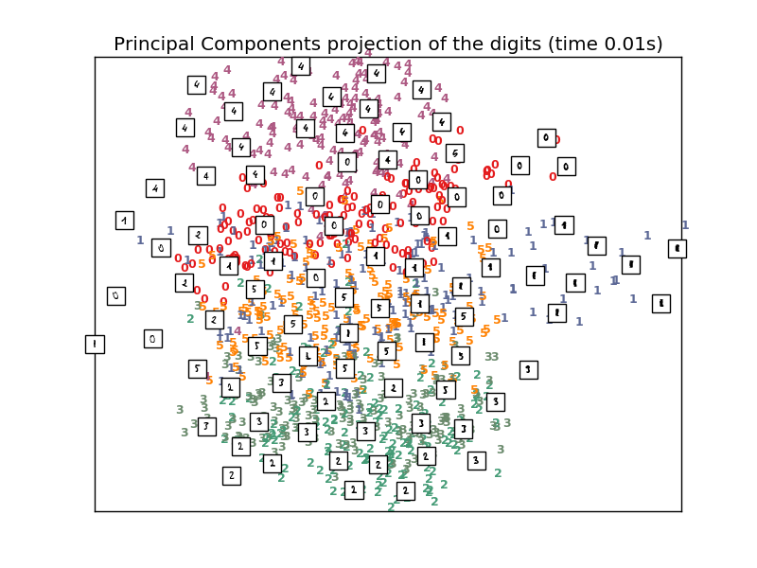
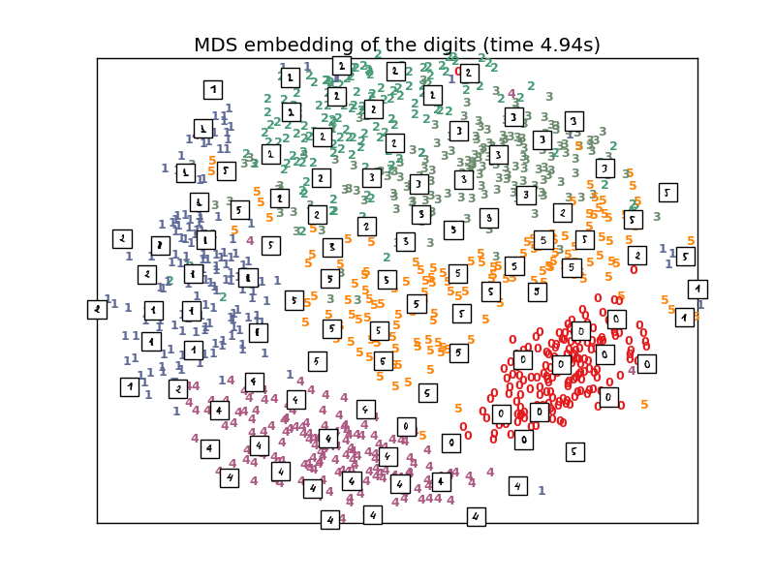
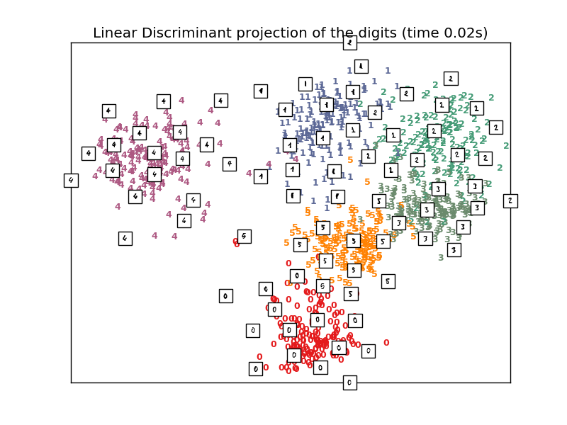
Application: Visualizing Feature Spaces

Slide 6
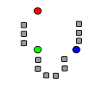
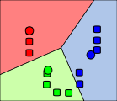
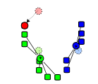
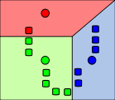
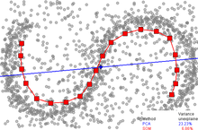
Unsupervised Feature Learning
Component Analysis: Principal / Independent
Clustering: K-Means Clustering -> Vector Quantization
Self-organizing maps
Neural networks nonlinear
generalization of PCA
Principally all kinds of Unsupervised Learning Schemes possible for Feature Learning

Slide 7
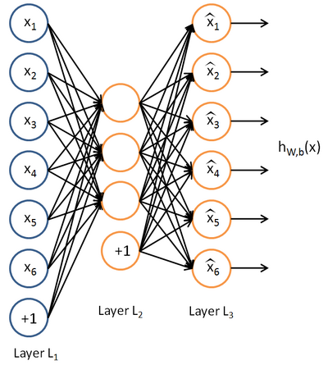
Multilayer/Deep architectures
Choosing features are one of the magics in machine learning. There are no clear engineering rules!
Recently Particularly in Image Recognition: Major Breakthroughs!
Why: Because of Computing Power and Large Datasets!
Autoencoder
Tries to learn the identity function
By restricting the function, ie. the number of nodes we can learn something like structure
We can stack those networks by learning an
Autoencoder of the hidden layer
Restricted Boltzmann machine
Another ANN that can learn probability distribution over its set of inputs.
deep belief networks can be formed by "stacking" RBMs

